Slide 1
Vietnamese Catholic Community
in
The Diocese Of Metuchen
By Joseph Nguyen

Slide 2
Vietnamese-american catholics in usa
A. The Vietnamese Exodus
History of Vietnam: 1954 and 1975
Living under the Vietnamese Communist Regime
Boat People
B. The Vietnamese American Catholics
Who Are Vietnamese Americans
Vietnamese Catholic Faith
Special Vietnamese Feasts / Events
C. Vietnamese Catholic Community - Diocese of Metuchen
The establishment of the Vietnamese Catholic Community
Pastoral & Cultural Activities
Concerns & Challenges
Opportunities
D. Personal Reflections
Notes:
Share some general info about Vietnamese catholics in USA and about our Vietnamese Catholic Community in this Diocese

Slide 3
The Vietnamese Exodus
A. The Vietnamese Exodus
History of Vietnam: 1954 and 1975
Living under the Vietnamese Communist Regime
Boat People
B. The Vietnamese American Catholics
Who Are Vietnamese Americans
Vietnamese Catholic Faith
Special Vietnamese Feasts / Events
C. Vietnamese Catholic Community - Diocese of Metuchen
The establishment of the Vietnamese Catholic Community
Pastoral & Cultural Activities
Concerns & Challenges
Opportunities
D. Personal Reflections
Notes:
Share some general info about Vietnamese catholics in USA and about our Vietnamese Catholic Community in this Diocese

Slide 4
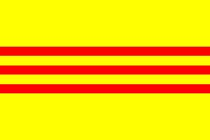
Vietnam in 1954
The North:
Democratic Republic of Vietnam
The South:
Republic of Vietnam
Notes:
1M fled North to South – 60% Catholic

Slide 5
1954 exodus from north to south
Notes:
Operation of “Passage to Freedom”. The sign welcomes Vietnamese Refugees onboard the American ship

Slide 6
1954 exodus from north to south

Slide 7
1954 exodus from north to south

Slide 8
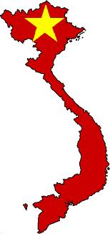
Vietnam in 1975
Socialist Republic of Vietnam
Notes:
The Communists of the North never gave up their ambition to take over the South. The South collapsed and the Vietnam war of 20 years ended in April 1975. The whole country is Communist now. The victory of the North is the misery 88

Slide 9
Living in the Vietnamese Communist Regime
Fear, oppression, persecution, brutality
Religions are oppressed – Freedom of worship is restricted – Seminaries are closed - Ordinations of Priests are banned
Famine, misery, poverty, hunger
Re-education camps – Families destroyed
People are put in prison without charges, without trial, e.g. the late Cardinal Francis Nguyen Van Thuan

Slide 10
The Vietnamese Exodus: Boat People
United Nations High Commissioner for Refugees (UNHCR) statistics:
1975-1996: 1.5 Million people fled Vietnam by boat to neighboring countries.
It’s estimated that at least 250,000 people died during escapes. 1 in 3 boat people never completed their journey.
How did the Vietnamese escape?
By boat or by land

Slide 11
Vietnam & southEast asia countries

Slide 12
My family Escape route

Slide 13
Overcrowded boat
Notes:
A very crowded boat

Slide 14
Boat people rescued by US NAVY Ship: USS BLUE RIDGE
Notes:
Awaiting to be rescued

Slide 15
Boat in danger
Notes:
The boat is in trouble

Slide 16
The Vietnamese American Catholics
A. The Vietnamese Exodus
History of Vietnam: 1954 and 1975
Living under the Vietnamese Communist Regime
Boat People
B. The Vietnamese American Catholics
Who Are Vietnamese Americans
Vietnamese Catholic Faith
Special Vietnamese Feasts / Events
C. Vietnamese Catholic Community - Diocese of Metuchen
The establishment of the Vietnamese Catholic Community
Pastoral & Cultural Activities
Concerns & Challenges
Opportunities
D. Personal Reflections
Notes:
Share some general info about Vietnamese catholics in USA and about our Vietnamese Catholic Community in this Diocese

Slide 17
The Vietnamese American Catholics
Immigrants versus refugees
2000 Census: +1 Million Vietnamese in USA
USA: 30% (300,000) are Catholic
Vietnam: 8% are Catholic
High rate of vocations:
+700 priests
60 permanent deacons
1200 sisters
200 communities and 41 personal parishes
2010 Census: +1.7 Million Vietnamese in USA
Most are living in states with warm weather

Slide 18
Vietnamese Catholic Faith
Strong Faith in God
Traditional Faith Practices:
Daily Mass
Devotion to the Sacred Heart of Jesus, Blessed Mother, and St. Joseph
Pray the Rosary
Respect for Priests and Religious
Vocations are fostered in the family:
Hope to have children be Priest / Nun

Slide 19
Special Vietnamese feasts/events
117 Vietnamese Martyrs Canonized by Pope John Paul II in 1988. Feast day November 24.
Our Lady of Lavang:
The first apparition of our Lady was noted in 1798 during the religious persecutions
Our Lady appeared as protective Mother, full of love for her suffering children
Marian Days: Annual festival and pilgrimage for Vietnamese Catholics – Carthage, MO

Slide 20
117 vietnamese martyrs: November 24

Slide 21
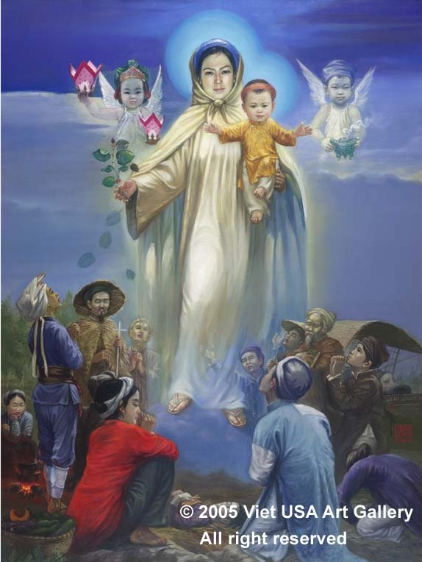
Our Lady of LaVang appeared to the persecuted

Slide 22
Marian Days in 8/2010

Slide 23
The Vietnamese Catholic Community
A. The Vietnamese Exodus
History of Vietnam: 1954 and 1975
Living under the Vietnamese Communist Regime
Boat People
B. The Vietnamese American Catholics
Who Are Vietnamese Americans
Vietnamese Catholic Faith
Special Vietnamese Feasts / Events
C. Vietnamese Catholic Community - Diocese of Metuchen
The establishment of the Vietnamese Catholic Community
Pastoral & Cultural Activities
Concerns & Challenges
Opportunities
D. Personal Reflections
Notes:
Share some general info about Vietnamese catholics in USA and about our Vietnamese Catholic Community in this Diocese

Slide 24
Establishment of the Vietnamese Catholic Community in Diocese of Metuchen
We brought Culture and Faith with us
Struggles: Language, Culture, Jobs
Joy: Religion is our center. Practice our traditional Faith in our language.
Formed a faith community to support spiritual, cultural, social, educational needs.
1987: Vietnamese Catholic Community (VNCC) was established
Notes:
Religion is our center. Faith is our comfort. We brought it with us.

Slide 25
St. Francis cathedral: 1987-1989

Slide 26
St. theresa mission church: 1989-1995

Slide 27
St james church: 1995-present

Slide 28
The Vietnamese Catholic Community
25th Anniversary: June 17, 2012
Thank You:
The Diocese of Metuchen
The Pastors & all parishioners of - St. Francis of Assisi Cathedral - St. Theresa and - St. James Parish.

Slide 29
The Vietnamese Catholic Community
Church is a place of worship
Sunday Vietnamese Mass
Special celebrations
Church is “home away from home”
Center of all activities
Occasions to get together and to strengthen bonds among us
Need to have a Vietnamese Priest

Slide 30
Head of community

Slide 31
The Vietnamese Catholic Community
Ministries:
Liturgy: Eucharistic Ministers, Altar Servers, Lectors, Music Ministry, Liturgy Committee, Sanctuary Prep.
Formation: Baptism, Fist Communion, Confirmation, RCIA, Marriage Prep.
Youth Ministry
Religious Organizations: Catholic Mothers, Cursillo, Legio Mariae, CLC
Homebound and Hospital Visitation

Slide 32
The Vietnamese Catholic Community
How VNCC keeps the Catholic Faith:
Promote family prayer: “Pray together, stay together”
Prayer service in honor of Our Blessed Mother each Saturday at a family’s home
Lent & Advent Retreats: Friday – Sunday
Retreats for Youth & Married Couples
Mass and Eucharistic Adoration on the first Friday of the month
Pastoral Council members: Silent Retreats

Slide 33
The Vietnamese Catholic Community
Pastoral Council
Social & Cultural Activities:
Community Website, Annual Magazine
Events Planning Committee
Food - Fun - Fair Committee
Vietnamese Language Classes
Annual Community Picnic
TET – Vietnamese New Year Mass & Performance Show
Notes:
TET – VN New Year has all fundamental values of VN Culture.

Slide 34
First communion 6/20/2010

Slide 35
Vietnamese language class 2009

Slide 36
Adult choir: Christmas 2010

Slide 37
New year mass 01/2012

Slide 38
New year performance show 2012

Slide 39
The Vietnamese Catholic Community
Concerns / Challenges:
Desire to have continuing Religious Education classes besides First Communion and Confirmation classes.
Wish to have Mass Schedule more convenient
Wish to have a Youth Mass in English
Need to help Youth & Young Adults to strengthen their Catholic spirituality

Slide 40
Opportunities
Opportunities for Vietnamese Catholics:
Freedom of Faith
Land of Opportunities
Opportunity to learn about and to get involved in issues of justice and peace and human life
Opportunity to be generous to the welfare of others, society, Church

Slide 41
Opportunity in the diocese

Slide 42
Personal reflections
Looking back at the last 25 years:
“God has done great things for us” (Psalm 126)
Promised Land
Divine Providence
God has a plan for each of us.

Slide 43
Vietnamese Catholic Community
in
The Diocese Of Metuchen
By: Le Tuyet
Pham Van Hoat

Slide 44
Vietnamese-catholic Family
Traditional family
Exodus and Resettlement in US
Personal Experiences of First Generation

Slide 45
Traditional family
In Vietnamese culture
Extended family
Characteristics
Emphasis on gender’s roles, privileges and obligations
- Of man
- Of woman
Filial piety
Love, respect, and obey
Solicitude and support to one’s parents, chiefly in their old age
Veneration of ancestors

Slide 46
Traditional family
In Vietnamese Catholic faith
Young and strong
Catholicism came to Vietnam in 16th Century
Only 6% population
300,000 martyrs
Daily practice
Nurturing Catholism
Devoting to Holy Mary
Devoting to Holy Mass
Participating in religious organizations
Highly respect and esteem priestly and religious vocation

Slide 47
Exodus & Resettlement in US
Exodus 1975-1987
First wave of refugees after April 30 1975
1975-1987: “Boat People”; an estimated one third percent died at sea;
Resettlement:
Initially dispersed across the country by US policy
Many resettled again in the big communities along the West Coast and the Gulf of Mexico

Slide 48
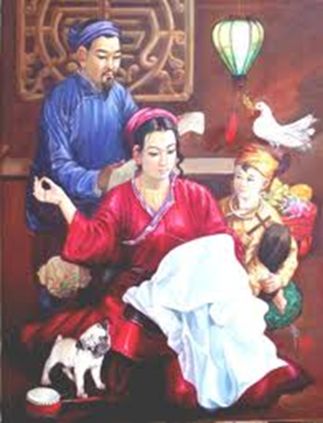
First Generation Experiences
From a woman’s view
From a man’s view

Slide 49
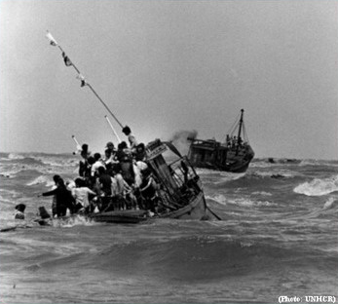
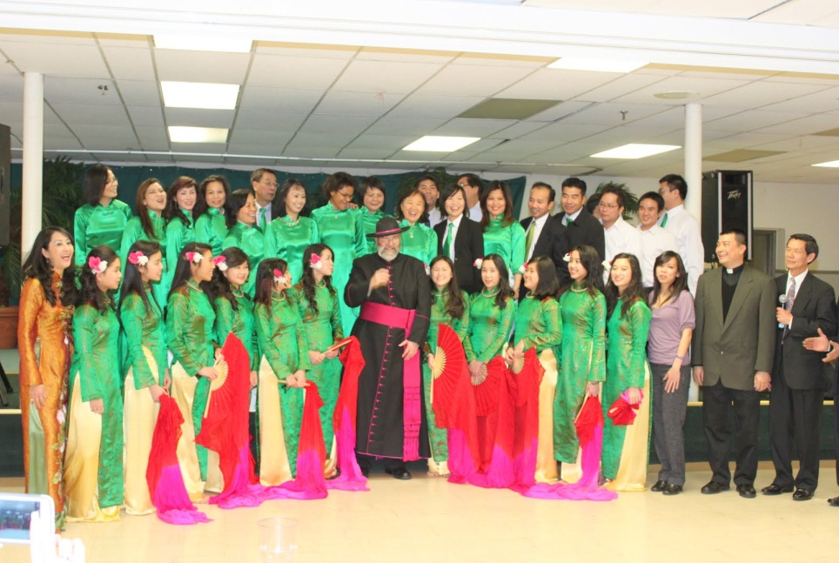
First generation experiences
Family background
Exodus Experiences
Adaption Experiences

Slide 50
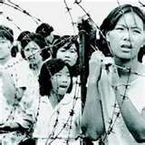
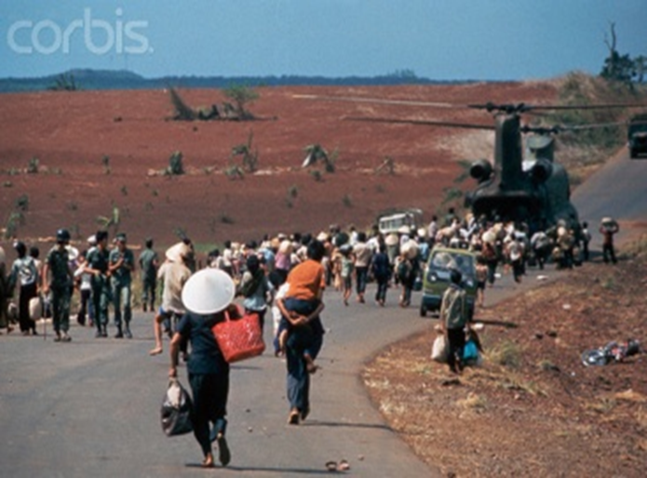
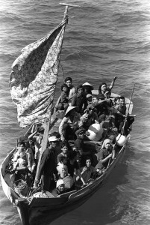
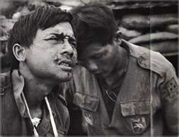
First generation experiences:
Family torn apart
Cope with new types of family

Slide 51
As a conclusion
How to strengthen and enrich Vietnamese Catholic families in the mainstream of American Catholic church?
Assimilated or integrated ?
Is it a program and an environment that can be culturally and pastorally workable for the first generation and nurture the younger generations?

Slide 52
Vietnamese Catholic Community
in
The Diocese Of Metuchen

Slide 53
The Second Generation
Presented by Linh Ho

Slide 54
The Second Generation
Parents Expectations
Native language
Respect and listening
Criticism versus encouragement
Education is the best path to a better future

Slide 55
The Second Generation
Parents Expectations
Identity Recognition
Vietnamese American or American?
Cultural Rebellion
My friends and I

Slide 56
The Second Generation
Parents Expectations
Identity Crisis
The Youth Group
Salt Of The Earth (SOTE)

Slide 57
Stations of the Cross - 1996

Slide 58
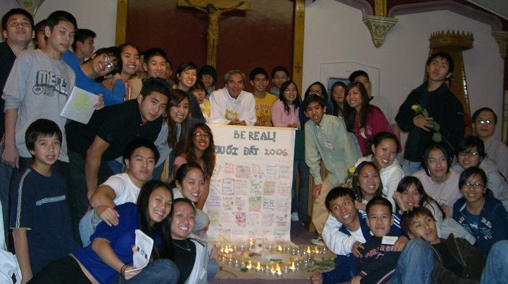
BE REAL!
2006

Slide 59
The Second Generation
Parents Expectations
Identity Crisis
The Youth Group
Salt Of The Earth (SOTE)
English is the language of choice
Challenge to recruit with fast turn over
Challenge to continue in college and after

Slide 60
The Second Generation
Parents Expectations
Identity Recognition
The Youth Group
Challenges for the Future
The community should be a place to foster and to welcome all generations sharing the same culture united in the Catholic Church.

